Slide 1
SYNOPSIS & PROGRESS PRESENTATION
(MILESTONE - 1)
on
REAL-TIME EXPERT SESSION BOOKING SYSTEM
For the course: FRONT END WEB DEVELOPMENT (26CA205PCB)
by
Vrinda Jindal (2628mca0260)
Tushar Sharma (2628mca0074)
Session: 2026-2027
Under the supervision of
Mr. Shashank Bhardwaj (Assistant Professor)
Department Of Computer Applications
KIET Deemed To Be University, Delhi-NCR, Ghaziabad-201206

Slide 2

2. Problem Statement
Current Challenges in Expert Consultation:
• Fragmented Expert Discovery: Clients must navigate multiple disconnected platforms to find verified specialists (Doctors, Lawyers, Cloud Engineers, CA, Tutors).
• Opaque Pricing Structures: Most websites hide consultation charges until after signup, making comparison difficult and causing user drop-off.
• Inefficient Scheduling & Double-Booking: Manual communication via calls or chat leads to missed slots, schedule friction, and appointment conflicts.
• Poor Mobile Responsiveness: Existing booking portals are heavy and difficult to use on smartphones and tablets.
The Need for a Solution:
• A single, modern web interface that combines verified expert listings, clear upfront pricing, and instant visual slot booking into one seamless platform.
Department of Computer Applications | KIET Deemed To Be University, Delhi-NCR

Slide 3
3. Project Objectives & Proposed Solution
Proposed Solution (BookingHub):
• A centralized frontend platform connecting users with verified industry mentors across 12 distinct professional categories.
• Transparent tiered consultation packages (e.g. ₹1,800 Discovery Call vs ₹2,500 Full Strategy Consultation).
• Interactive calendar-based appointment scheduling with visual availability feedback.
Core Project Objectives:
• Develop a 100% responsive, multi-page frontend optimized for mobile (360px) to desktop (1920px) screens.
• Implement real-time search and category filtering across verified expert profiles.
• Design an interactive 3-state time slot picker (Available, Selected, Booked).
• Implement clean client-side authentication and instant booking management.
Department of Computer Applications | KIET Deemed To Be University, Delhi-NCR

Slide 4
4. Project Scope
Key Functional Modules Included:
• Home Page: Industry category grid covering 12 major sectors with one-click direct access.
• Search & Discovery: Real-time search by mentor name, industry, and specialization keywords.
• Profile & Booking Studio: Verified mentor dossier, package selection, calendar date picker, and time slot selection.
• Authentication: Dedicated login interface for both clients and experts.
• Client-Side Data Management: Complete end-to-end booking flow running locally in browser memory.
Technical Capabilities & Deliverables:
• Fluid client-side navigation with zero page reload delays.
• Interactive UI components: Sticky navbar, category pills, profile cards, and booking chips.
• Standalone project execution running on localhost:3000 with zero external dependencies.
Department of Computer Applications | KIET Deemed To Be University, Delhi-NCR

Slide 5
5. Technology Stack
Frontend Core Technologies:
• HTML5: Clean semantic markup (<header>, <nav>, <main>, <section>, <article>, <form>, <footer>).
• CSS3: Modern responsive design using Flexbox, CSS Grid, Glassmorphism, CSS Variables, and Media Queries.
• JavaScript (ES6+): Client-side interactivity, DOM manipulation, dynamic filtering, and browser localStorage state.
• React.js & Vite: Fast, component-driven modular frontend structure with sub-second hot reload.
Development Tools & Version Control:
• Code Editor: Visual Studio Code (VS Code) with modern web development extensions.
• Testing Browser: Google Chrome & Chrome DevTools for cross-device viewport inspection.
• Version Control: Git & GitHub repository for source code tracking and academic submission.
• Runtime Server: Lightweight local web server running on Port 3000.
Department of Computer Applications | KIET Deemed To Be University, Delhi-NCR

Slide 6
6. Hardware & Software Requirements
Hardware Requirements:
• Processor: Intel Core i3 / AMD Ryzen 3 or higher.
• RAM: 4 GB minimum (8 GB recommended for multitasking).
• Disk Space: 500 MB minimum available hard disk storage.
• Display: Standard screen resolution (1366x768 or 1920x1080).
Software Requirements:
• Operating System: Windows 10/11, macOS, or Linux.
• Web Browser: Google Chrome, Mozilla Firefox, or Microsoft Edge.
• Development Environment: Visual Studio Code.
• Runtime Environment: Node.js (v18+) and Python 3.
Department of Computer Applications | KIET Deemed To Be University, Delhi-NCR

Slide 7
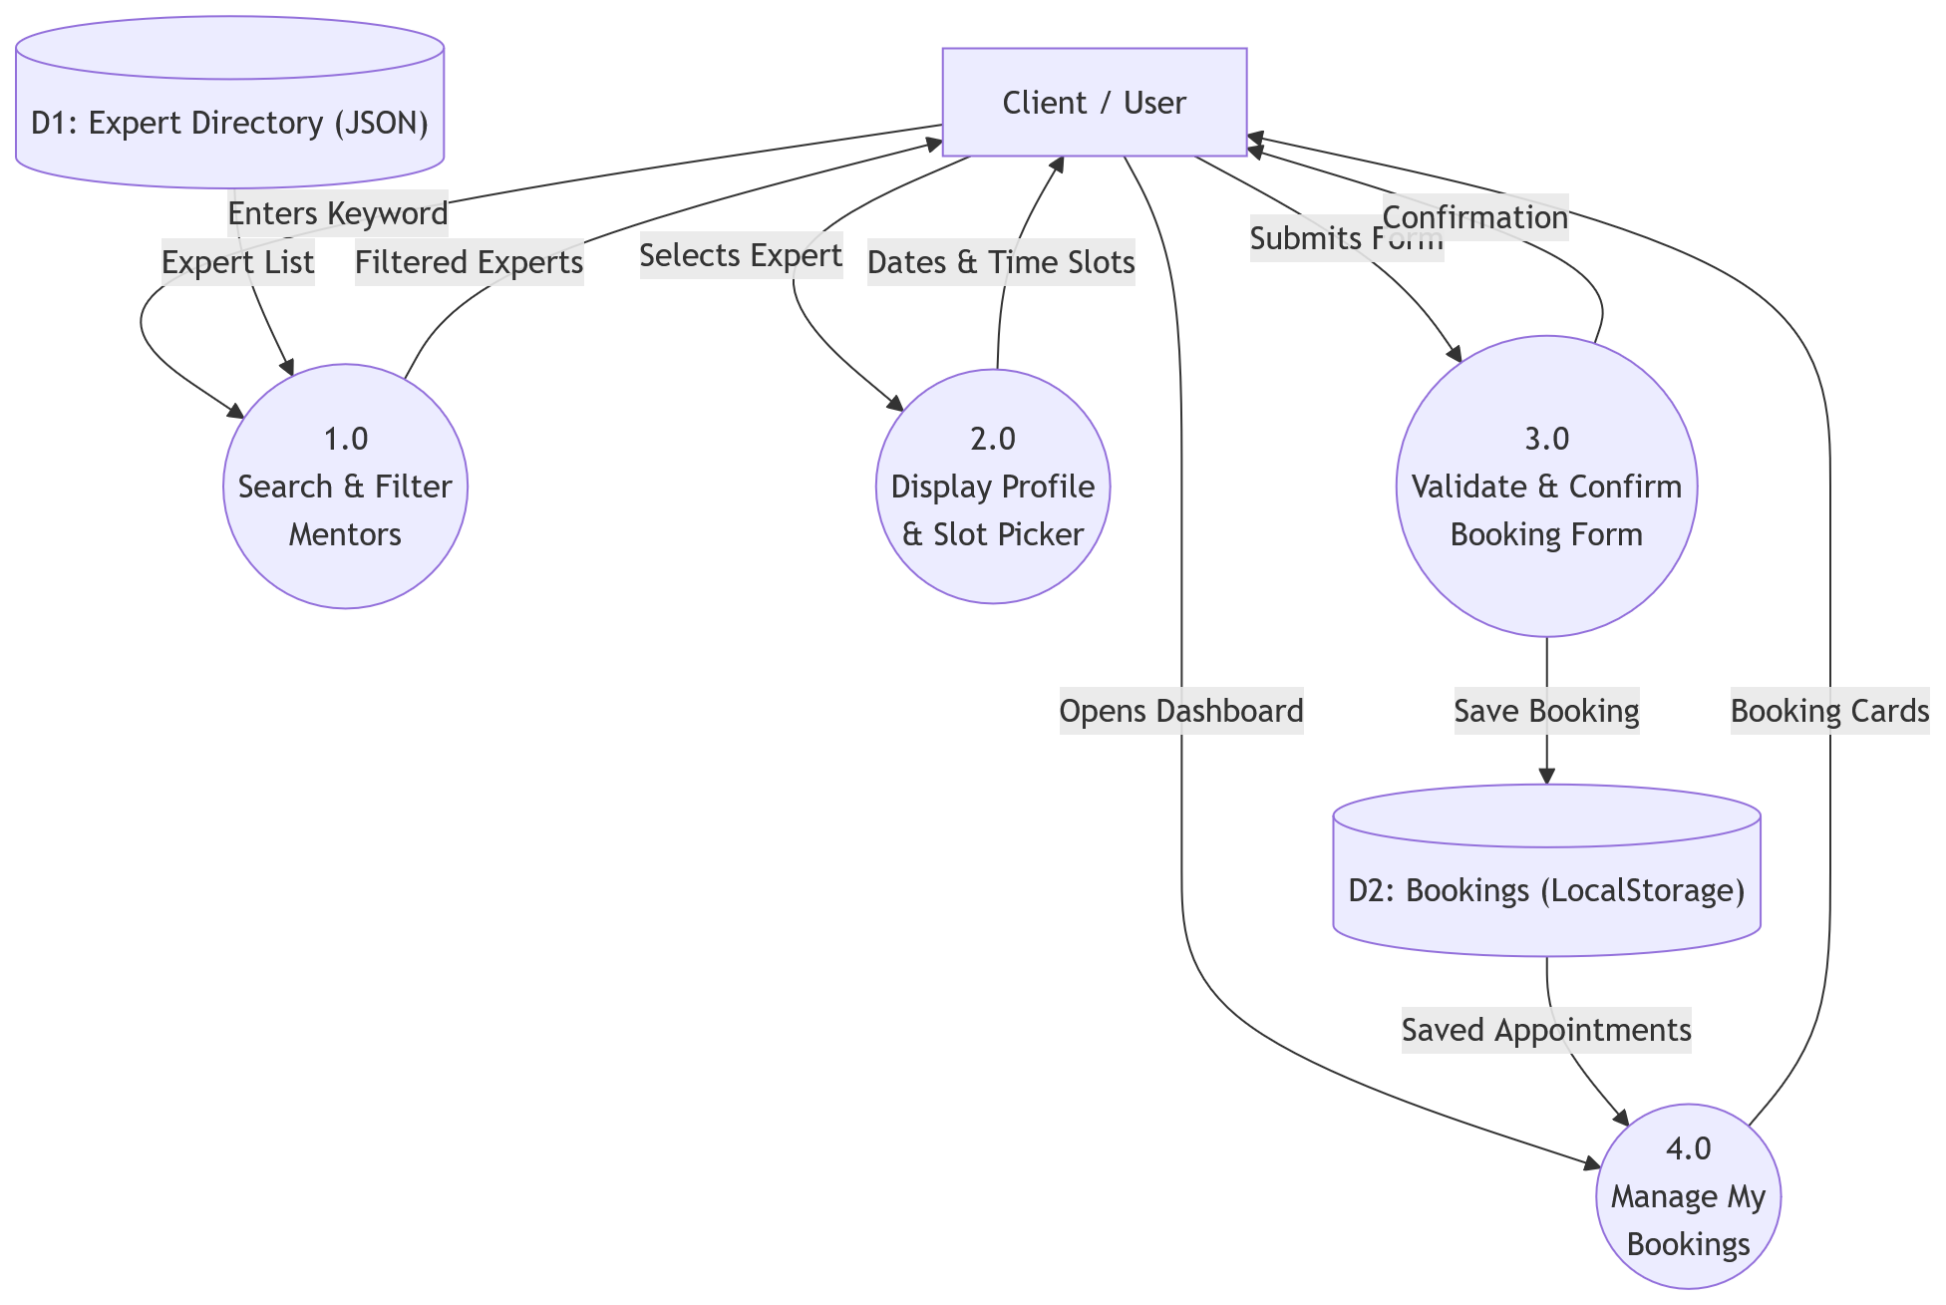
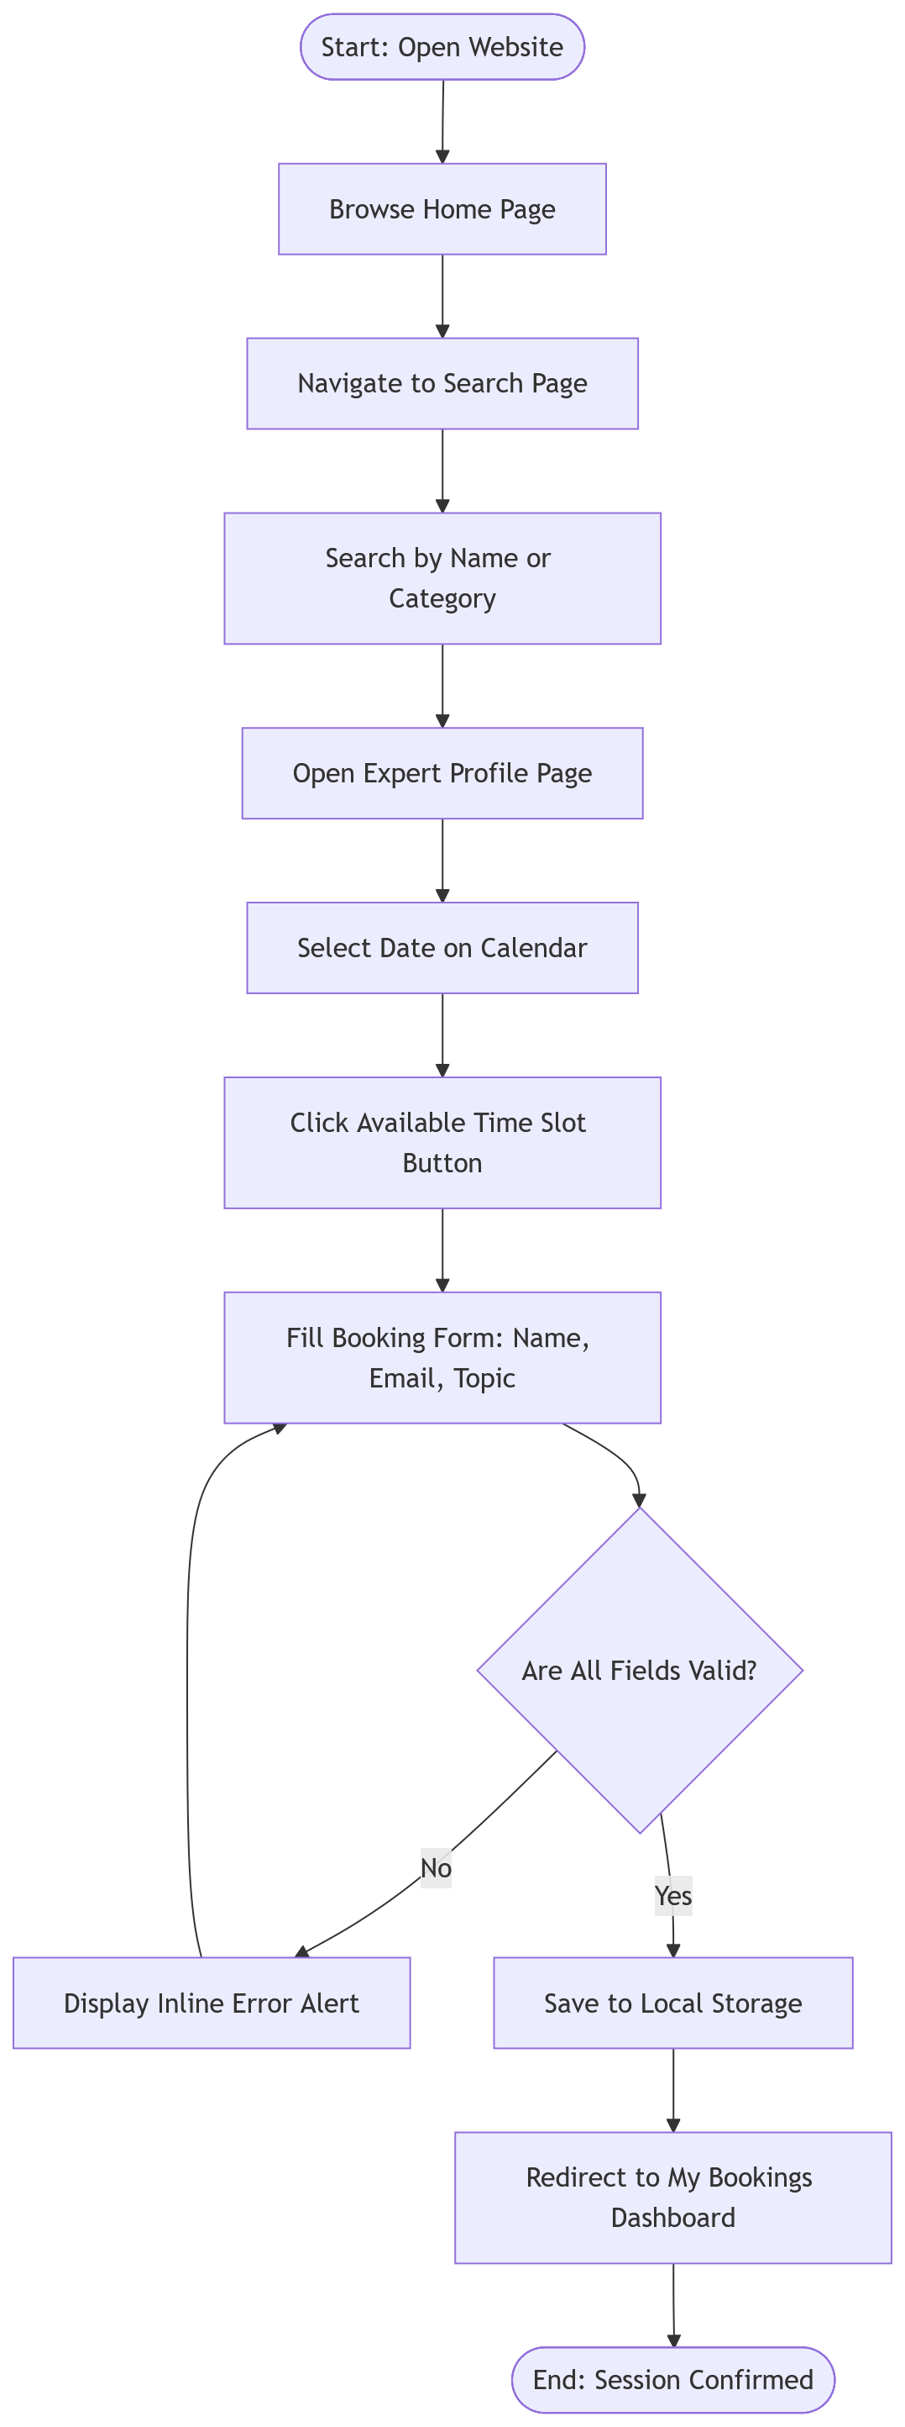
7. System Architecture & Workflows
Use Case Diagram (Actors & Interactions)
System Flowchart (End-to-End Booking Lifecycle)
• The diagrams illustrate how clients discover mentors, select packages, choose available slots, and confirm appointments.
Department of Computer Applications | KIET Deemed To Be University, Delhi-NCR

Slide 8
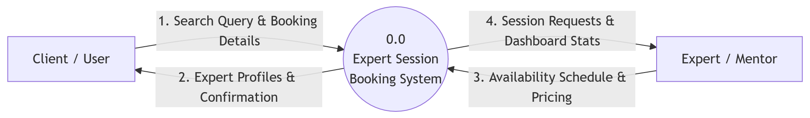
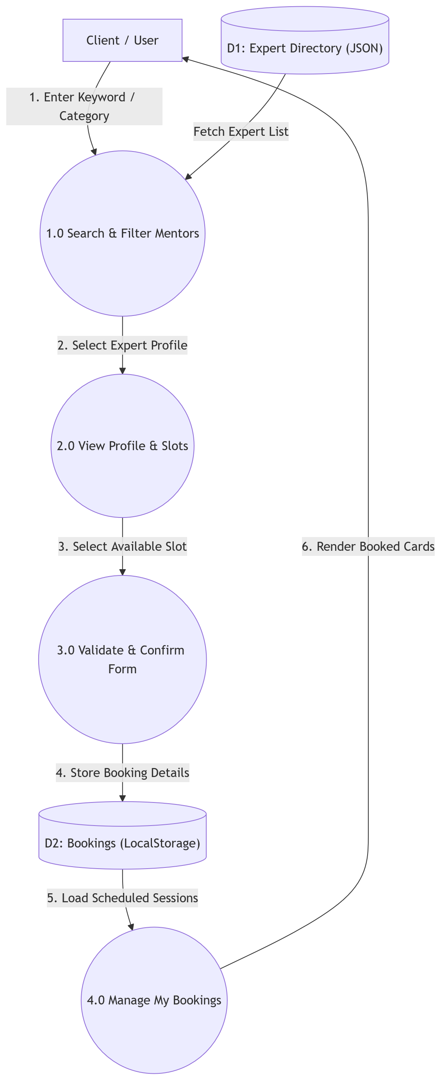
8. Data Flow Diagrams (DFD Level 0 & Level 1)
DFD Level 0 (Context Level Diagram)
DFD Level 1 (Modular Data Flow Breakdown)
• Level 0 shows the system boundary, while Level 1 details user authentication, expert search, slot validation, and session confirmation.
Department of Computer Applications | KIET Deemed To Be University, Delhi-NCR

Slide 9
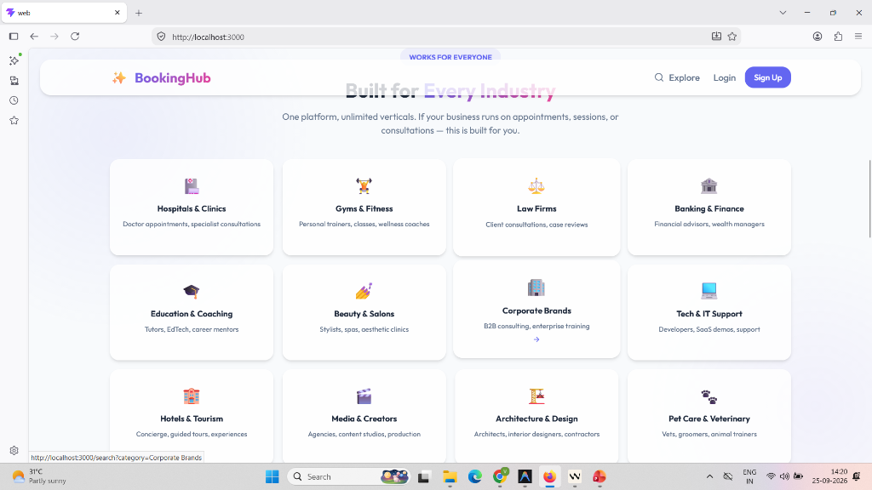
9. Live Project: Home Page
Key Features:
• Hero Title: 'Built for Every Industry' highlighting platform versatility.
• Category Grid: 12 key industry hubs (Hospitals, Gyms & Fitness, Law Firms, CA & Tax, Tech & IT, etc.).
• One-Click Access: Users click any industry tile to immediately view verified experts.
• Clean Visual Design: Modern card hover effects, clean icons, and professional spacing.
Live Project Screen: Home Landing Page (Industry Category Grid)
Department of Computer Applications | KIET Deemed To Be University, Delhi-NCR

Slide 10
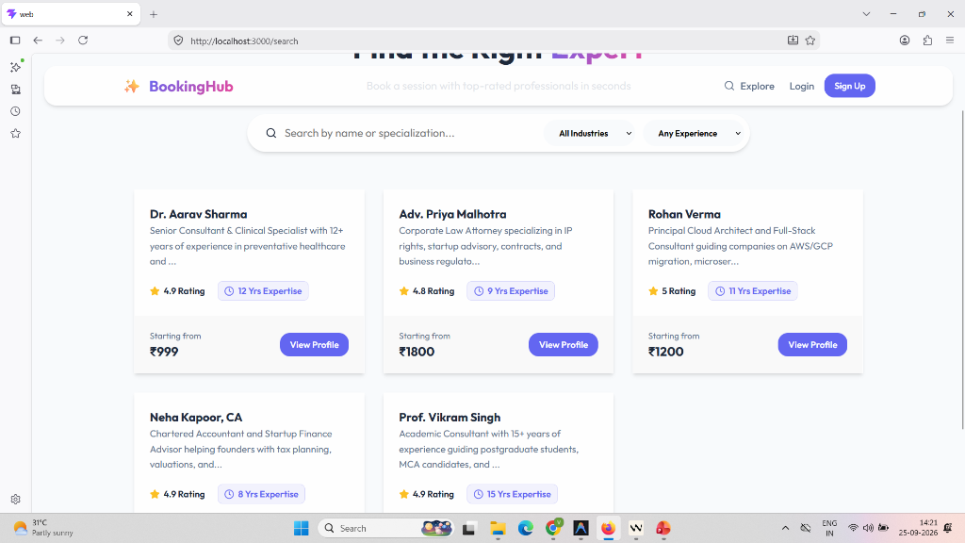
10. Live Project: Search & Filter Mentors
Key Features:
• Quick Search Bar: Search by mentor name, expertise, or company keywords.
• Filter Buttons: Instant category pills (All, Health, Fitness, Legal, Tech, Finance).
• Expert Cards: Displays Dr. Aarav Mehta, Adv. Priya Malhotra, Rohan Verma, and Neha Kapoor.
• Direct Action: 'Book Session' button on each card leads straight to that mentor's booking schedule.
Live Project Screen: Mentor Directory (/search)
Department of Computer Applications | KIET Deemed To Be University, Delhi-NCR

Slide 11
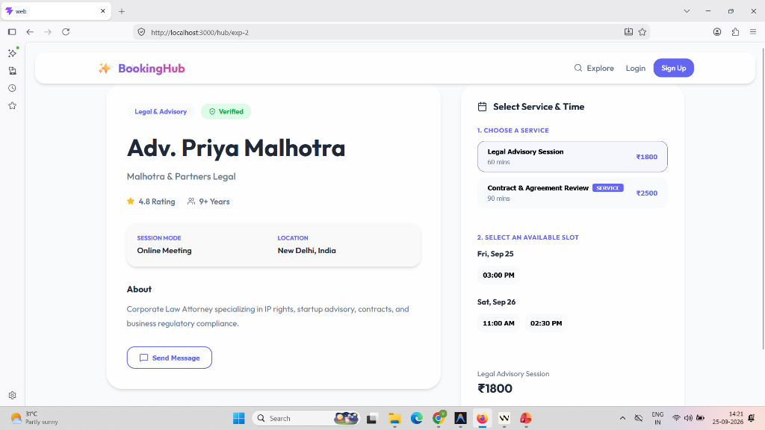
11. Live Project: Expert Profile & Slot Booking
Key Features:
• Mentor Dossier: Profile for Adv. Priya Malhotra (Corporate Legal Advisory, 11 yrs exp).
• Service Packages: Transparent options (e.g. ₹1,800 Discovery Call vs ₹2,500 Full Strategy).
• Date Selector: Interactive date chips (Today, Tomorrow, and upcoming dates).
• Interactive Time Slots: Clear visual buttons (10:00 AM, 11:30 AM, 2:00 PM) for simple slot selection.
Live Project Screen: Profile & Booking Studio (/hub/:id)
Department of Computer Applications | KIET Deemed To Be University, Delhi-NCR

Slide 12
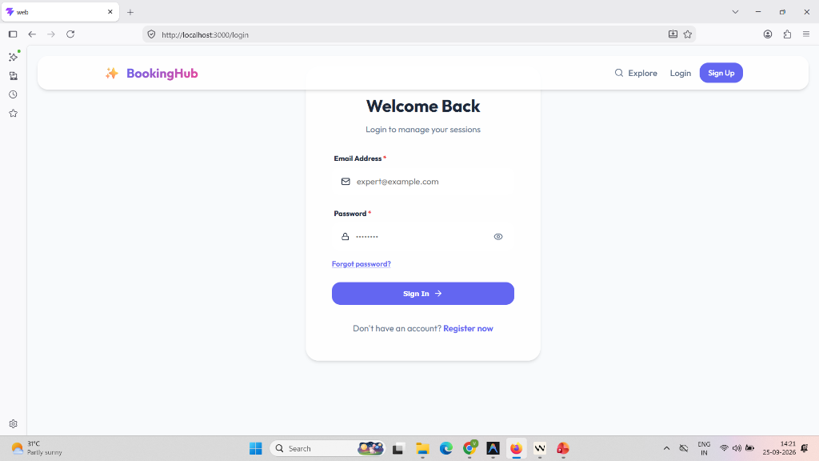
12. Live Project: Client & Expert Login
Key Features:
• Clean Sign-In Form: Email and password fields with instant validation.
• Role-Based Access: Supports both Client and Expert login workflows.
• Session Management: Remembers logged-in user state in the browser.
• Responsive Card Layout: Centered, distraction-free authentication interface.
Live Project Screen: User Authentication (/login)
Department of Computer Applications | KIET Deemed To Be University, Delhi-NCR

Slide 13
13. Project Outcome & Deliverables
Delivered Project Capabilities:
• Complete Frontend Web App: 4 core functional views (Home, Search, Booking Studio, Login).
• Multi-Industry Support: 12 industry categories with verified mentor listings.
• Interactive Slot Booking: Transparent service packages and visual calendar slots.
• Mobile-Friendly & Responsive: Works smoothly across mobile phones, tablets, and laptops.
Academic Deliverables:
• Clean Codebase: Cleanly organized HTML5, modern CSS3, and JavaScript.
• Version Control: Full project source code committed and uploaded to GitHub.
• Local Execution: Runs directly on localhost:3000 with zero complex setup.
Department of Computer Applications | KIET Deemed To Be University, Delhi-NCR

Slide 14
THANK YOU!
Questions & Answers (Q&A)
Presented by:
Vrinda Jindal (2628mca0260) | Tushar Sharma (2628mca0074)
Under the Supervision of:
Mr. Shashank Bhardwaj (Assistant Professor)
Department of Computer Applications
KIET Deemed To Be University, Delhi-NCR, Ghaziabad-201206

